Slide 1

Atomic Structure
Reference
Chemistry by Raymond Chang
General Chemistry by Ebbing

Slide 2
Democritus
In the fifth century b.c. the Greek philosopher Democritus expressed the belief that all matter consists of very small, indivisible particles, which he named atomos (meaning uncuttable or indivisible)
Dalton
1. Elements are composed of extremely small particles, called atoms.
2. All atoms of a given element are identical, having the same size, mass, and chemical properties. The atoms of one element are different from the atoms of all other elements.
3. Compounds are composed of atoms of more than one element. In any compound, the ratio of the numbers of atoms of any two of the elements present is either an integer or a simple fraction.
4. A chemical reaction involves only the separation, combination, or rearrangement of atoms; it does not result in their creation or destruction.
1808
law of conservation of mass, which is that matter can be neither created nor destroyed

Slide 3
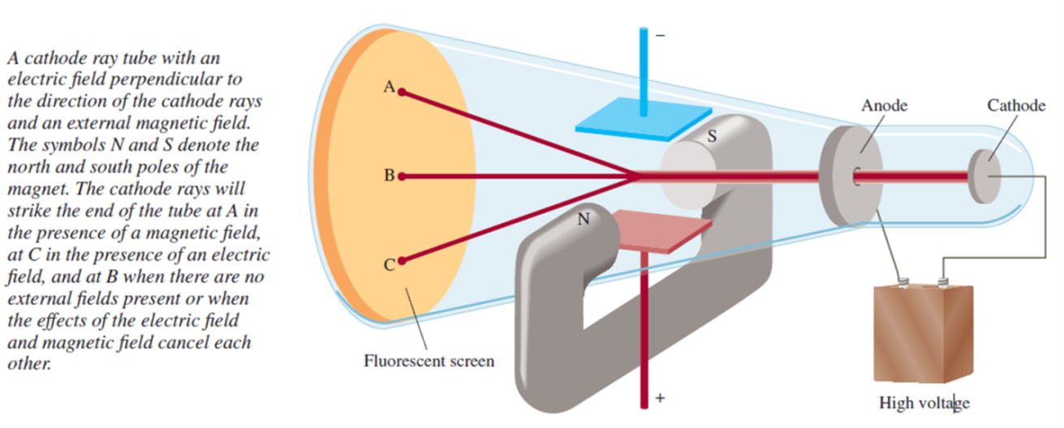
The Electron
1890s
Radiation , emission and transmission of wave

Slide 4
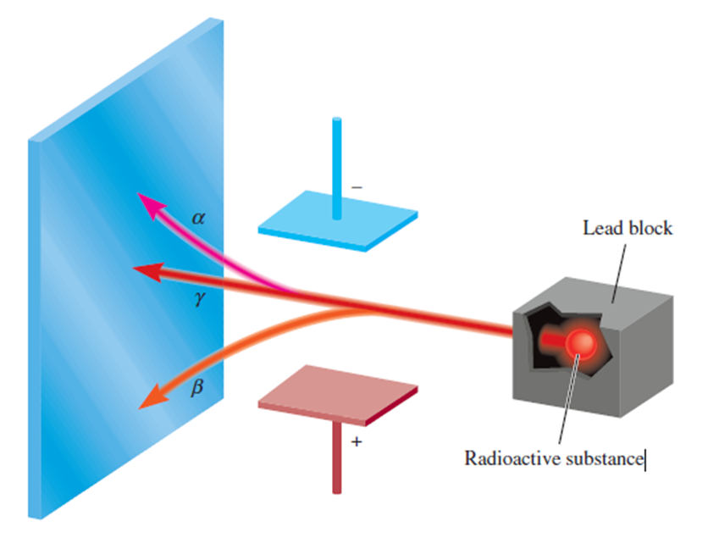
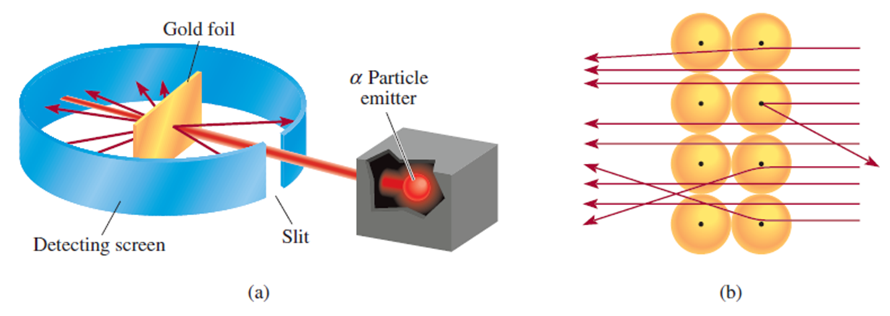
Radioactivity
X-ray by Rontgen in 1895
γ-ray by Becquerel
Radioactivity by Marie Curie
Isotops by Fedrick in 1913
Limitations of Dalton’s Atomic Model
Proton and Nucleus
Rutherford (1910)
Gaiser
Marsden

Slide 5
Rutherford Atomic Model
a. An atom consists of a small nucleus containing all the positively charges
b. The nucleus is surrounded by a number of electrons equal to the number of positive charges on the nucleus.
c. The electrons are in constant motion round the nucleus like that of planets round the sun
Limitations
The major limitation of Rutherford’s model of atom is: the radiating energy of revolving electron continuously decreases the energy of the electron which will eventually make the electron to fall into the nucleus. So, the model couldn’t explain the stability of an atom. Also, the observed spectra of different elements couldn’t be explained by this mode
According to Rutherford’s model
an atom consists of a nucleus many times smaller than the atom itself, with electrons occupying the remaining space.
How the electrons are distributed in the space?
What are the electrons doing in the atom?

Slide 6
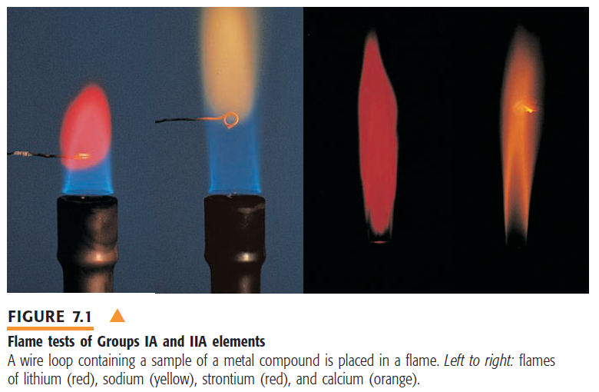
Quantum theory of atom (Ebbing)
After a prism you will get something other than the rainbow, a cluster of colored lines in black background: Ex. Li will show a red, a yellow and two blue lines
How each elements emits particularly color of light?

Slide 7
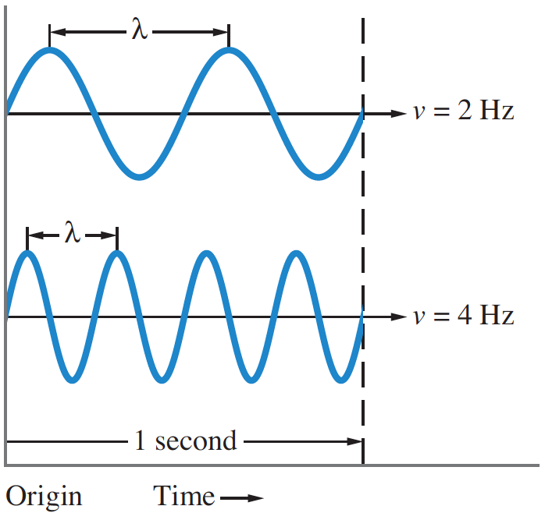
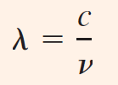
The Wave Nature of Light
The speed of light waves, c, is 3.00 × 10⁸ m/s
This speed ‘c’ in a vacuum is a constant and is independent of wavelength or frequency.

Slide 8
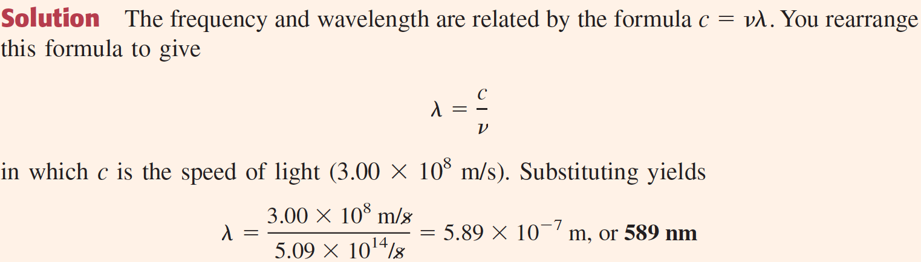
Obtaining the Wavelength of Light from its Frequency
Problem 1. What is the wavelength of the yellow sodium emission, which has a frequency of 5.09 × 10¹⁴/s?
Similarly, you can obtain the frequency of light from its wavelength

Slide 9
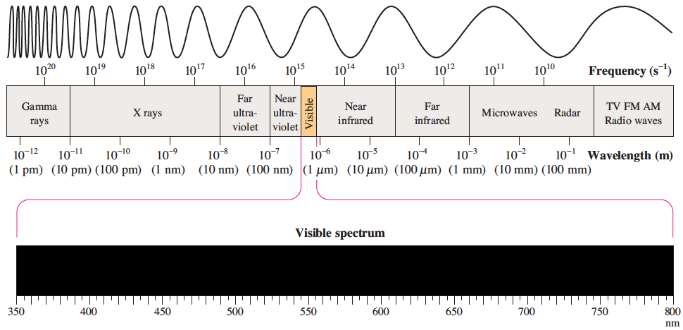
Electromagnetic Spectrum
The range of frequencies or wavelengths of electromagnetic radiation is called the electromagnetic spectrum,

Slide 10
Quantum effect and Photon (Ebbing)
Issac Newton
in the seventeenth century, believed that light consisted of a beam of particles
Thoomas Young
In 1801, however, British physicist Thomas Young showed that light, like waves, could be diffracted.
Diffraction is a property of waves in which the waves spread out when they encounter an obstruction or small hole about the size of the wavelength.
Albert Einstein
In 1905 he explain photoelectric effect by postulating that light had both wave and particle properties.
Plank’s quantization of Energy
(1890)
E= nhν
ν Is the frequency of vibration, n = 1, 2, 3, . . . where h is a constant, now called Planck’s constant(6.63 ×10⁻³⁴J.s.)

Slide 11
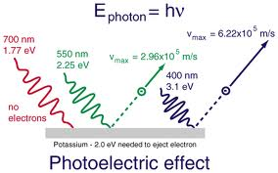
Photoelectric Effect
light consists of quanta (now called photons), or particles of electromagnetic energy, with energy E proportional to the observed frequency of the light:
E=hν
The wave and particle pictures of light should be regarded as complementary views of the same physical entity. This is called the wave–particle duality of light

Slide 12
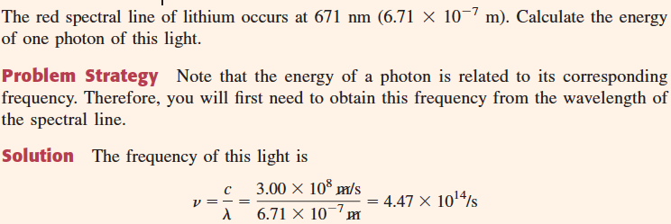
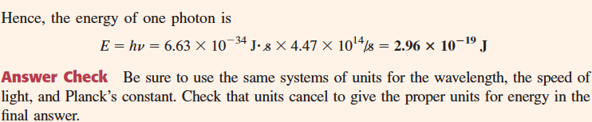
Calculating the Energy of a Photon

Slide 13
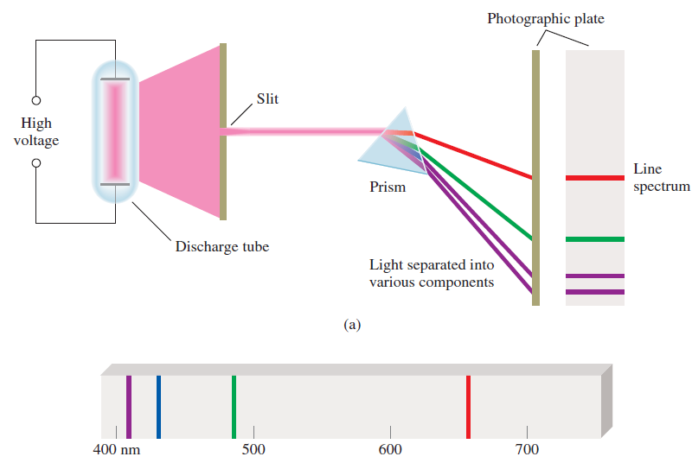
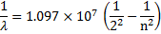
Emission Spectra/Atomic Spectra/Atomic line spectra
Balmer showed
Where n is greater than 2. . By substituting n = 3, for example, and calculating 1/λ and then λ, one finds λ= 6.56×10⁻⁷ m, or 656 nm, a wavelength corresponding to red light

Slide 14
Bohr’s Model
To explain
the stability of the hydrogen atom
the line spectrum of the atom.
Bohr’s Postulate:
1. Energy-level Postulate: An electron can have only specific energy values in an atom, which are called its energy levels.
E= - (R_{H}/n²) where n= 1, 2, 3 --- ∞
where R_{H} is a constant (expressed in energy units) with the value 2.179 ×10⁻¹⁸ J called Rydberg constant
2. Transitions Between Energy Levels: An electron in an atom can change energy only by going from one energy level to another energy level. By so doing, the electron undergoes

Slide 15
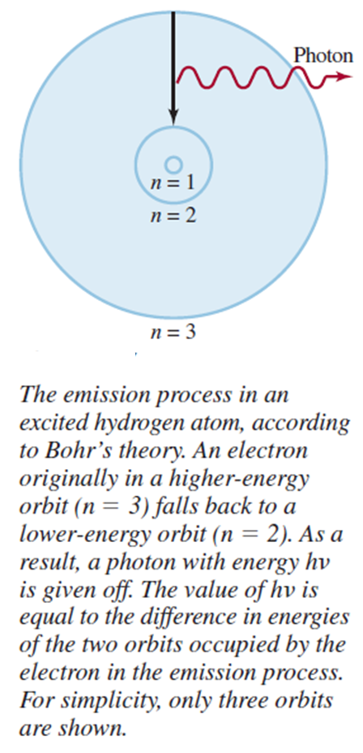
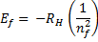
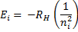
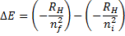
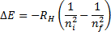
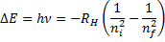
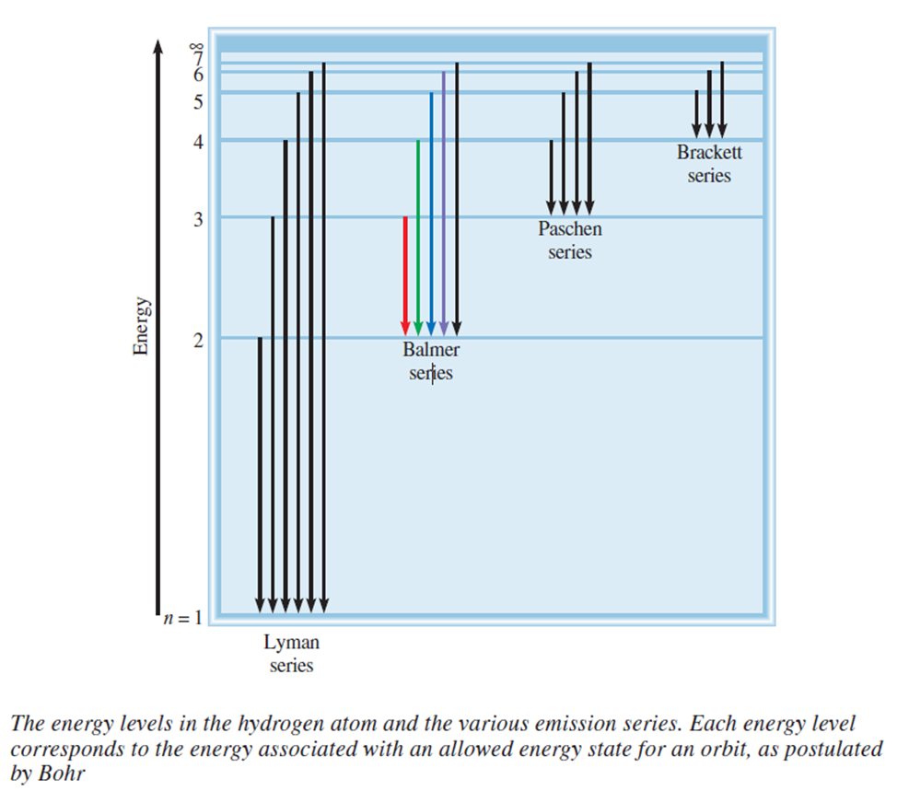
Hydrogen Spectrum

Slide 16
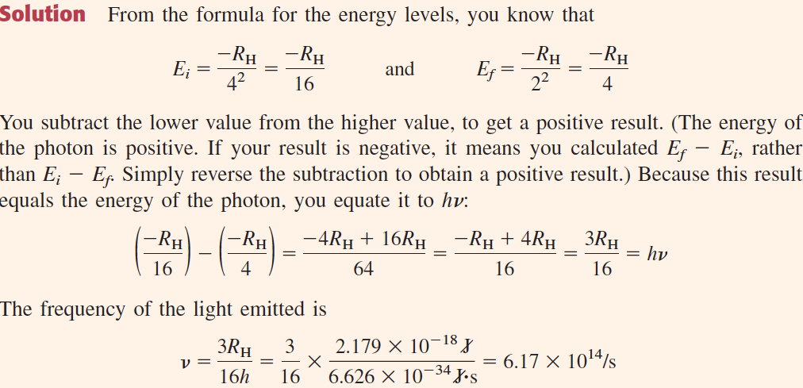
What is the wavelength of light emitted when the electron in a hydrogen atom undergoes a transition from energy level n = 4 to level n = 2?

Slide 17
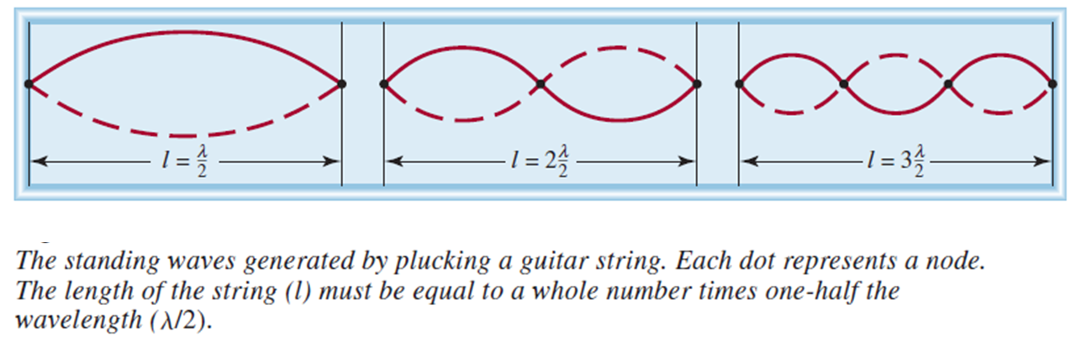
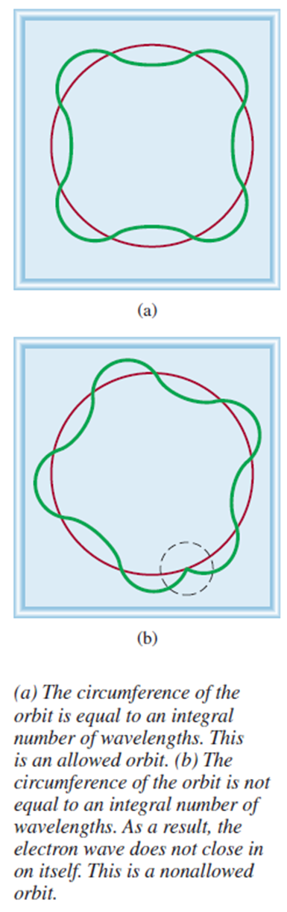
Duel nature of electron
(de Broglie 1924)
Why energies of electros are quantized??
Why electrons are orbiting in a fixed distance??
Circumference of an orbit 2πr = nλ
de Broglie, λ = h/(mv)
Combining the two equation mvr = h/2π
The angular momentum of electrons are quantized

Slide 18
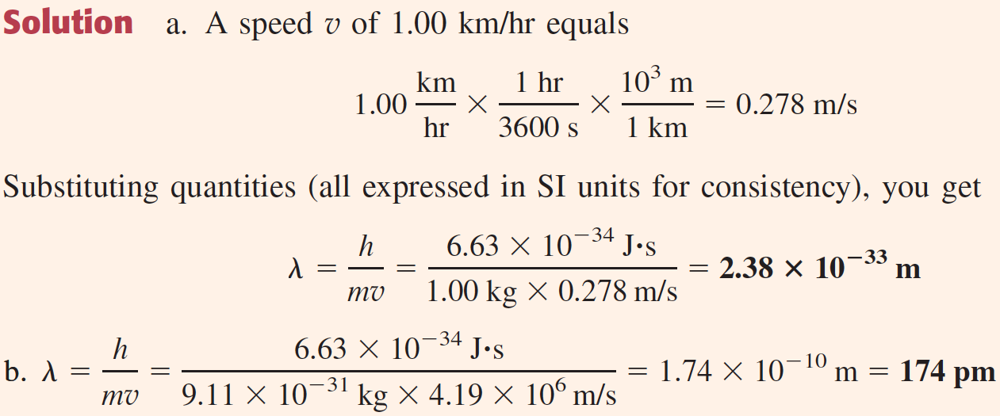
Wavelength of a Moving Particle
a. Calculate the wavelength (in meters) of the wave associated with a 1.00-kg mass moving at 1.00 km/hr. b. What is the wavelength (in picometers) associated with an electron, whose mass is 9.11 × 10⁻³¹ kg, traveling at a speed of 4.19 × 10⁶ m/s?
For 1 kg mass, the wavelength is so incredibly small that such waves cannot be detected. Under the proper circumstances, the wave character of electrons should be observable.

Slide 19
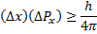
Heisenberg Uncertainty Principle
Limitations of Bohr’s theory
(i). Bohr’s Model could not explain the spectra of atoms containing more than one electron.
(ii). It could not explain the Zeeman effect. In presence of magnetic field, each spectral line gets split up into fine lines, the phenomenon, is known as Zeeman effect.
(iii). It could not explain the Stark effect. In presence of electric field, each spectral line gets split up into fine lines, the phenomenon, is known as Stark effect.
The main objection to Bohr’s model was raised by Heisenberg’s uncertainty principle
If the electrons are wave then How can the position of a wave be specified???
Heisenberg uncertainty principle: It is impossible to know simultaneously both the momentum (mass times velocity) and the position of a particle with certainty. Heisenberg’s uncertainty principle is a relation that states that the product of the uncertainty in position and the uncertainty in momentum of a particle can be no smaller than Planck’s constant divided by 4π.

Slide 20
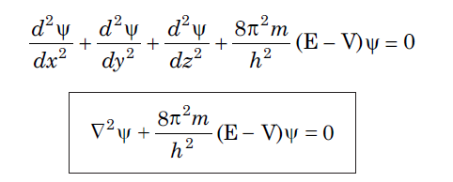
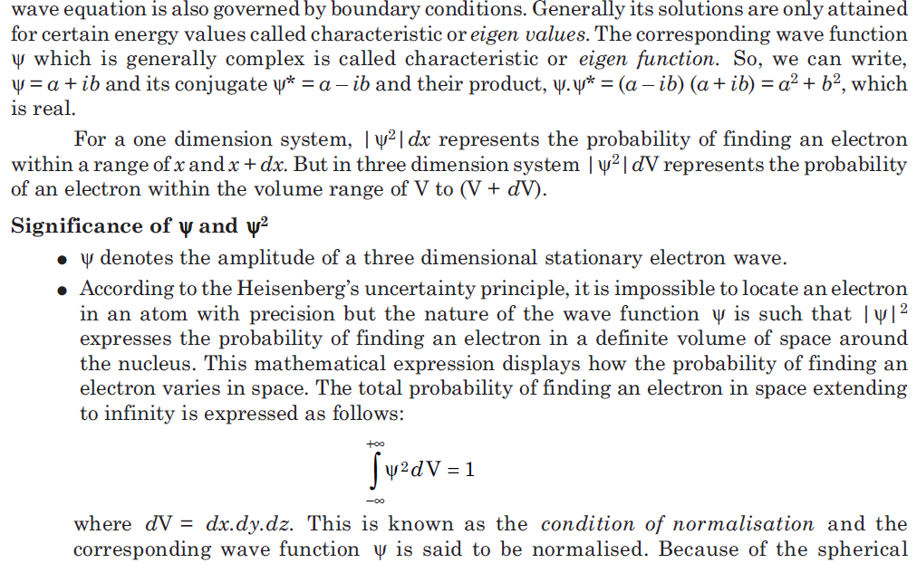
Schrödinger wave equation (1926)
The branch of physics that mathematically describes the wave properties of submicroscopic particles is called quantum mechanics or wave mechanics

Slide 21
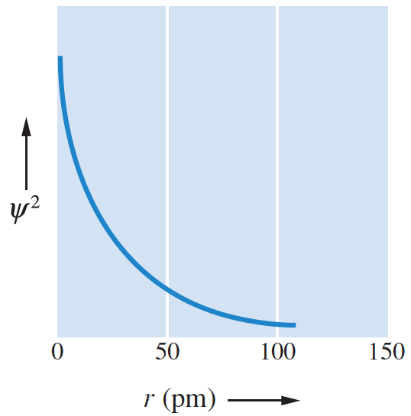
Wave Functions
Information about a particle in a given energy level (such as an electron in an atom) is contained in a mathematical expression called a wave function, denoted by the Greek letter psi, Ψ.
The wave function is obtained by solving an equation of quantum mechanics (Schrödinger’s equation).
Ψ², gives the probability of finding the particle within a region of space.
The wave function and its square, Ψ², have values for all locations about a nucleus.
Ψ² is large near the nucleus (r = 0), indicating that the electron is most likely to be found in this region.
The value of Ψ² decreases rapidly as the distance from the nucleus increases, but Ψ² never goes to exactly zero.

Slide 22
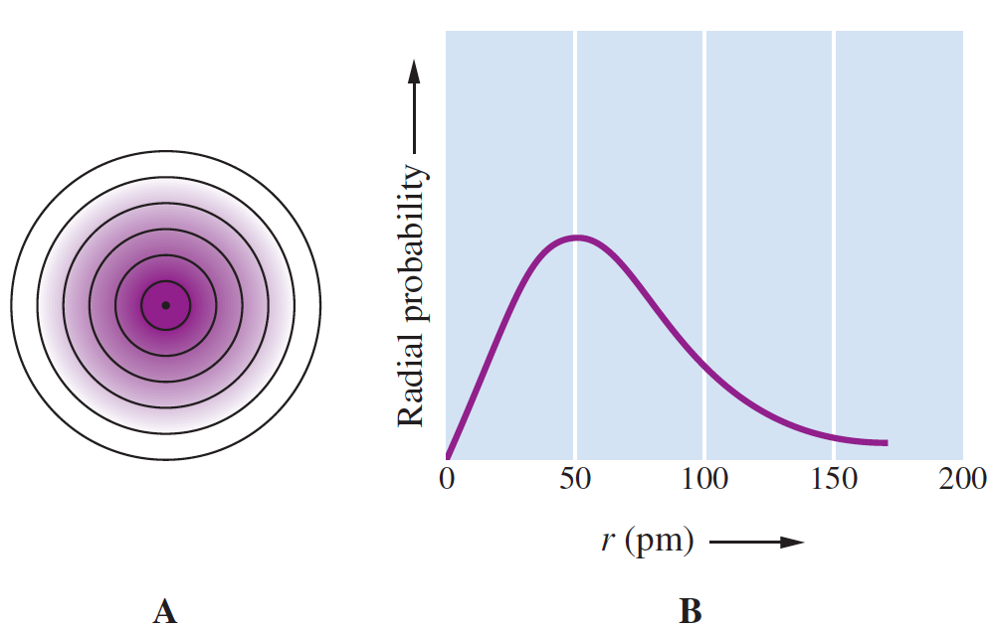
Wave Functions
The diagram shows the probability density for an electron in a hydrogen atom. The region is marked off in shells about the nucleus.
The graph shows the probability of finding the electron within shells at various distances from the nucleus (radial probability).

Slide 23
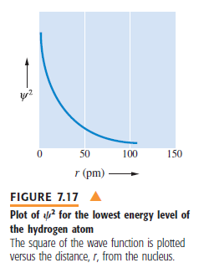
Probability Distribution
Atomic Orbital concept
To distinguish the quantum mechanical description of an atom from Bohr’s model, we speak of an atomic orbital, rather than an orbit. An atomic orbital can be thought of as the wave function of an electron in an atom.

Slide 24
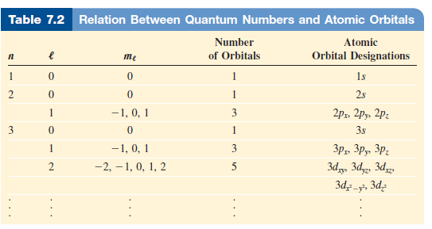
The Principal Quantum Number (n)
Quantum number
Quantum numbers are the mathematical solutions Schrödinger equation
The Principal Quantum Number (n) determines the energy of the electron
The Angular Momentum Quantum Number (l) tells the shape of the orbital
The magnetic Quantum number (m) describes the orientation of the orbital in space
The Spin Quantum number (m) describes spin of the electron in its own axis

Slide 25
Quantum Numbers and Atomic Orbitals
Each electron in an atom is described by four different quantum numbers, three of which (n, l, and m_{l}) specify the wave function that gives the probability of finding the electron at various points in space.
A wave function for an electron in an atom is called an atomic orbital. An atomic orbital is pictured qualitatively by describing the region of space where there is high probability of finding the electrons.
A fourth quantum number (m_{s}) refers to a magnetic property of electrons called spin.
We first look at quantum numbers, then at atomic orbitals.

Slide 26
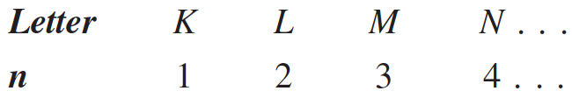
Principal Quantum Number
Principal Quantum Number (n): This quantum number is the one on which the energy of an electron in an atom principally depends.
It can have any positive value: 1, 2, 3, and so on.
The energy of an electron in an atom depends principally on n. The smaller n is, the lower the energy.
The size of an orbital also depends on n. The larger the value of n is, the larger the orbital. Orbitals of the same quantum state n are said to belong to the same shell.
Shells are sometimes designated by the following letters:

Slide 27
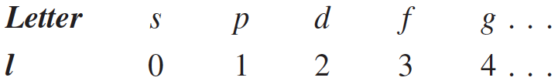
Angular Momentum QN
2. Angular Momentum QN or Azimuthal QN (l): This quantum number distinguishes orbitals of given n having different shapes
It can have any integer value from 0 to n – 1.
Within each shell of QN n, there are n different kinds of orbitals, each with a distinctive shape denoted by an l QN.
Although the energy of an orbital is principally determined by the n QN, the energy also depends somewhat on the l QN. For a given n, the energy of an orbital increases with l.
Orbitals of the same n but different l are said to belong to different subshells of a given shell.
The different subshells are usually denoted by letters as follows:
Notes:
For example, if an electron has a principal quantum number of 3, the possible values for l are 0, 1, and 2. Thus, within the M shell (n = 3), there are three kinds of orbitals, each having a different shape for the region where the electron is most likely to be found. in this section.

Slide 28
Magnetic QN
3. Magnetic Quantum Number (m_{l}): This quantum number distinguishes orbitals of given n and l — that is, of given energy and shape but having a different orientation in space
The allowed values are the integers from -l to +l.
The orbitals have the same shape but different orientations in space.
All orbitals of a given subshell have the same energy.
There are 2l + 1 orbitals in each subshell of QN l.
Notes:
For example, if an electron has a principal quantum number of 3, the possible values for l are 0, 1, and 2. Thus, within the M shell (n = 3), there are three kinds of orbitals, each having a different shape for the region where the electron is most likely to be found. in this section.

Slide 29
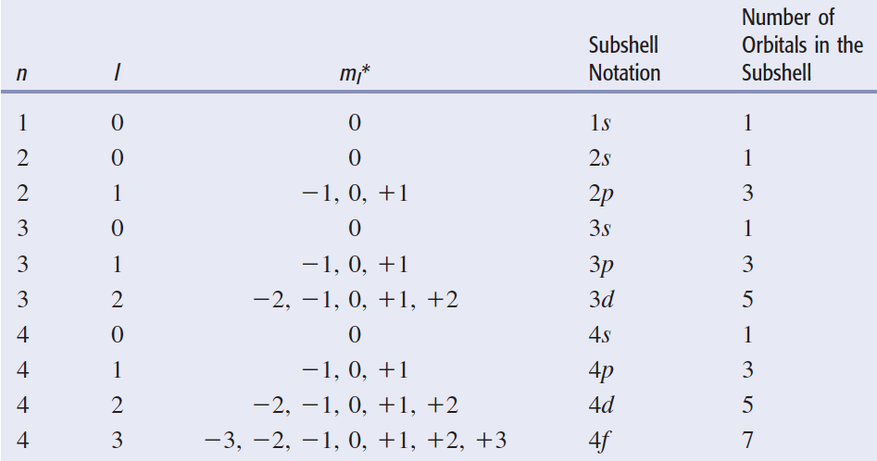
Permissible Values of QN for Atomic Orbitals

Slide 30
Spin QN
4. Spin Quantum Number (m_{s}): This quantum number refers to the two possible orientations of the spin axis of an electron
Possible values are +1/2 – and -1/2.
An electron acts as though it were spinning on its axis like the earth.
Such an electron spin would give rise to a circulating electric charge that would generate a magnetic field.
In this way, an electron behaves like a small bar magnet, with a north and a south pole.

Slide 31
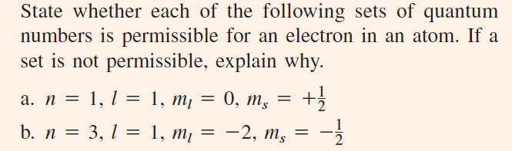
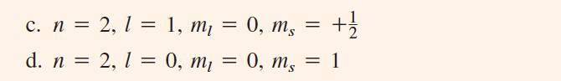
Applying the Rules for QN

Slide 32
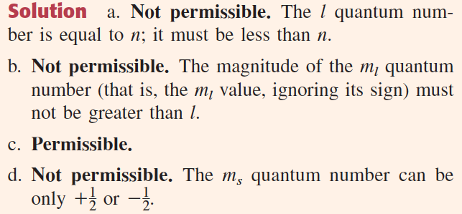
Applying the Rules for QN

Slide 33
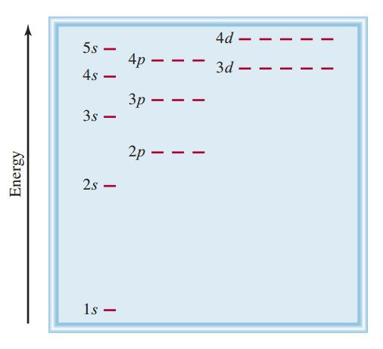
Orbital energy levels

Slide 34
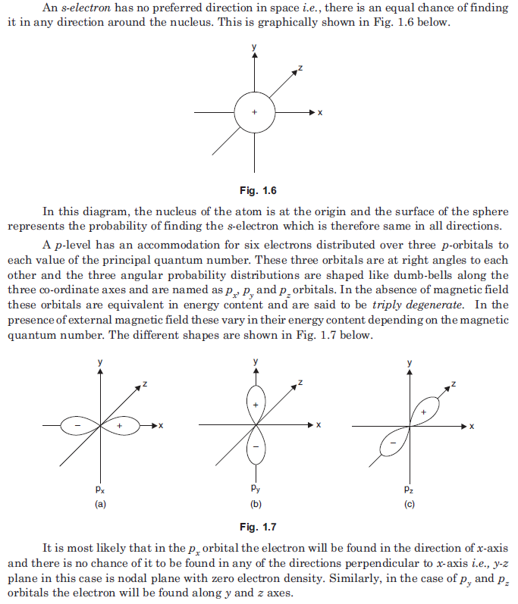
Shapes of orbital
S-orbital
P-orbital

Slide 35
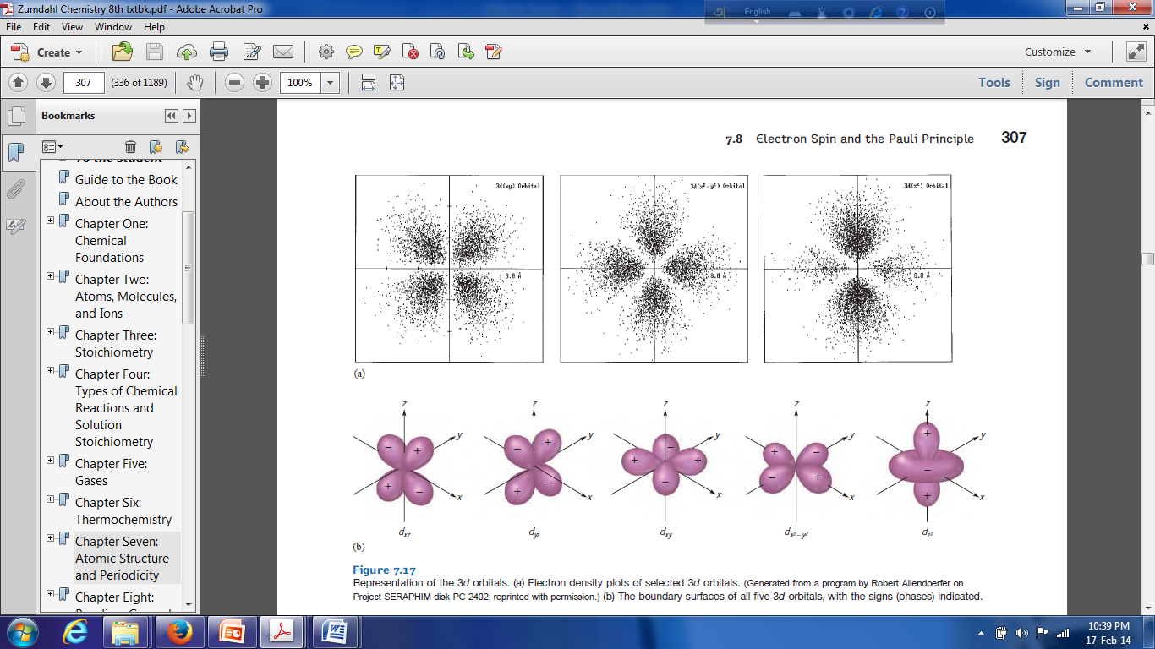
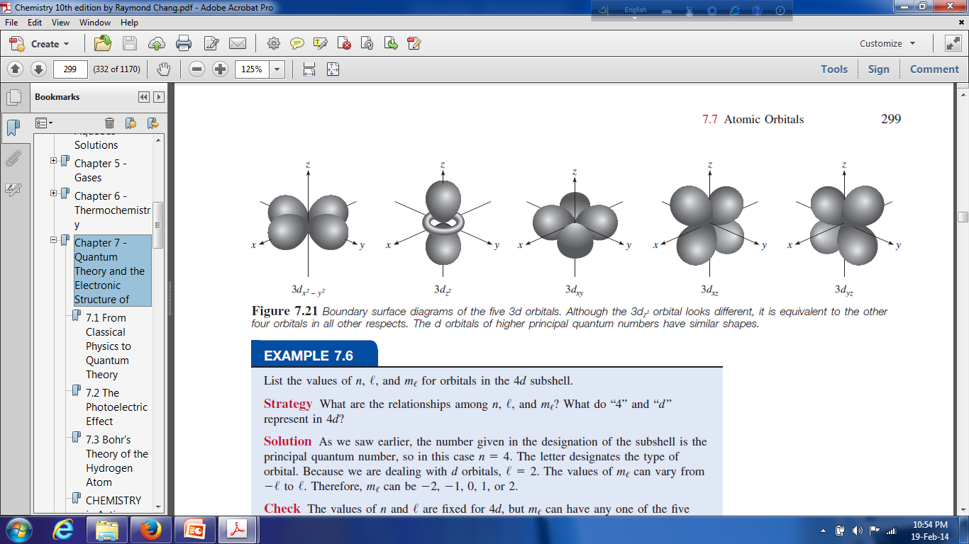
D-orbital

Slide 36
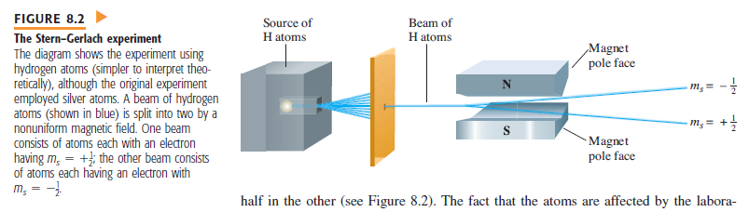
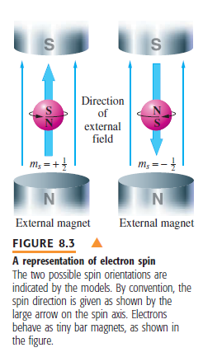
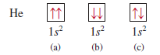
Electron Spin and Pauli exclusion principle
This principle states that no two electrons in an atom can have the same four quantum numbers

Slide 37
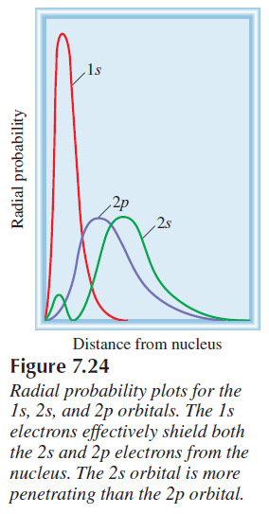
Diamagnetism and paramagnetism
Paramagnetic substances are those that contain net unpaired spins and are attracted by a magnet.
Diamagnetic substances do not contain net unpaired spins and are slightly repelled by a magnet.
Justification of Pauli Exclusion principle
Shielding effect
In fact, for the same principal quantum number n, the penetrating power decreases as the angular momentum quantum number , increases, or
s > p > d > f >. . . .

Slide 38
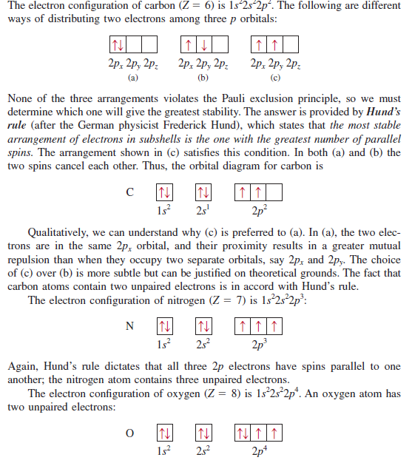
Hund’s rule
Hund’s rule states that the most stable arrangement of electrons in sub-shell is the one with the greatest number of parallel spin
Aufbau principle
The Aufbau principle dictates that as protons are added one by one to the nucleus to build up the elements, electrons are similarly added to the atomic orbitals.

Slide 39
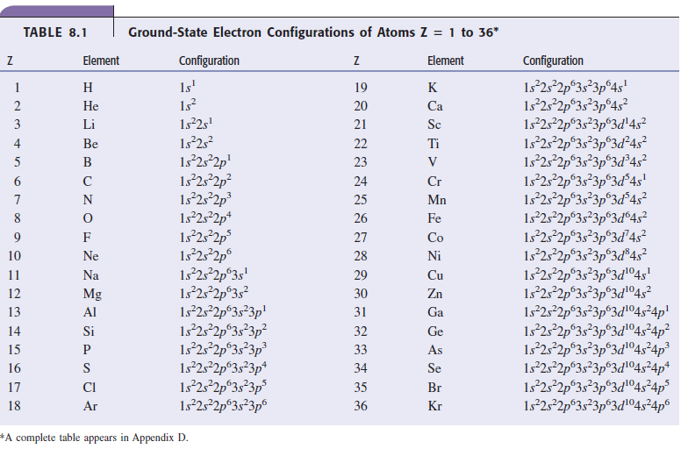

Slide 40
